Slide 1
West Sussex Safeguarding Children Partnership Business Plan April 2023 – March 2026
Priority 1
Strengthening effectiveness of our multi-agency practice
Priority 2
Child Sexual Abuse: Protecting and safeguarding our children
Priority 3 Tackling Child Exploitation
Priority 5
Children’s emotional health and wellbeing
Priority 4 Children as victims of Domestic Abuse

Slide 2
Introduction
A key WSSCP focus is to continue to drive improvements to the fundamentals of partnership working, addressing practice and system challenges as well as recurring issues.
The WSSCP’s Business Plan provides a framework to support delivery of activity which has been identified by WSSCP partner agencies and organisations as a strategic priority area for learning, improvement and/or further development. These priority work streams were selected as areas needing the most immediate attention, narrowed down from twelve potential themes/topics.
The five priority areas are to be delivered between April 2023 and March 2026 and they will have a one to three year delivery timescale; this approach provides additional flexibility to accommodate emerging priority areas needing a response from WSSCP partner agencies and organisations.
Our lead partners, Sussex Police, West Sussex County Council and NHS Sussex are accountable for effective delivery of the Business Plan. Our annual report evidences the impact of the Partnership’s work on outcomes for children and families. Annual reports also set out the reasons why where there has been little or no evidence of progress made on agreed priorities and what action is needed to overcome barriers to effective Partnership working.
By focussing our resources in this way we are confident that as a Partnership we are driving improvements to the way we work together to safeguard children and their families across West Sussex.
The West Sussex Safeguarding Children Partnership’s (WSSCP) local arrangements support the co-ordination of work across West Sussex to safeguard and promote the welfare of children and to ensure the effectiveness of the work member organisations undertake both individually and together.
Responsibility for this join-up rests with the safeguarding partners who have a duty to make arrangements to work together to safeguard and promote the welfare of all children in a local area.
Our vision is to keep children young people in West Sussex safe by: by:
Co-ordinating our local safeguarding activity
Being a driving force to improve local practice
Ensuring that all agencies fulfil their safeguarding responsibilities effectively
2

Slide 3
Our Business Plan Priorities
The WSSCP’s 2023-26 Business Plan priorities are informed by:
Local and national data sources
Learning from local child safeguarding practice reviews and audits
National learning such as Child Safeguarding Practice Review Panel reports and briefings as well as Children’s Commissioner’s and NSPCC research
Inspection reports e.g. Ofsted Joint Targeted Inspection Reports
Implementing national guidance
Changes to legislation and policy
A good understanding of ‘what good looks like’ and the actions we need to take to achieve this.
How we will deliver our priorities
Our business plan priorities will be delivered through the WSSCP’s sub-groups which will report to the lead partners via Steering Group at least 4 times per annum.
We will work collaboratively with Partnerships and Boards in West Sussex, as well as Pan Sussex programmes and audits. This approach helps us to ensure that collectively we focus on co-ordination of services whilst working to continuously improve outcomes for children and families.
3

Slide 4
Strategic Priority 1 Strengthening the effectiveness of our multi-agency practice Lead partner: WSCC Children’s Social Care April 2023-March 2026
Expected Outcome for children
Children, young people and families who need help and protection receive high quality and effective multi-agency intervention and support when they need it.
Why we chose this priority
By strengthening our muti-agency systems and practice we can ensure we are keeping children safe - so that children, young people and families stay together and get the help they need.
Learning from Reviews and audits have identified recurring practice findings across the Partnership which require resolution via (i) focussed improvements and (ii) testing the impact of changes to systems and practice such as by audit and staff surveys.
How we will deliver this priority
Voice and Participation:
Ensure inclusive child centred practice, which fully recognises and responds to intersecting needs of children, families and communities whose voices are seldom heard
Voluntary and Community Sector voice
Schools and colleges are engaged in the WSSCP’s work
Improving Systems and Practice:
A shared understanding of thresholds of need
Effective communication/information sharing
Escalation (of professional differences) to safeguard children
Build on progress already made at identifying and responding to neglect and ‘break the cycle’ of intergenerational neglect
Consistent commitment to partnership working, with shared expectations
Independent scrutiny programme to test effectiveness of systems and practice
Use data to inform strategy and monitor progress.
4

Slide 5
Strategic Priority 2 Child Sexual Abuse (CSA): Protecting and safeguarding our children Lead
Lead Partner: Sussex Police April 2023-March 2025
Expected outcome for children
Develop and embed a cohesive multi-agency approach to effectively safeguard and support children who have suffered or are at risk of CSA.
Why we chose this priority
Government research and data highlights the complexity of this work and the need to have a clear understanding of and response to CSA. Recent child safeguarding review findings highlighted that practitioners and managers should be better supported to recognise and respond to CSA. risks and need.
How we will deliver this priority
Embedding systems and practice which enable professionals to recognise and respond to indicators of CSA and provide interventions and ongoing support.
Utilise findings of inspection reports to inform systems and practice improvement and development, including:
Harmful sexual behaviours: Ofsted review of sexual abuse in schools and colleges
Joint Targeted Area Inspection (JTAI): Multi-agency response to child sexual abuse in the family environment
Implement the findings of the Independent Inquiry into Child Sexual Abuse
Robust preventative action so that children understand how to keep safe and where appropriate, timely prosecution of abusers.
5

Slide 6
Strategic Priority 3 Tackling Child Exploitation
Lead Partner: Sussex Police April 2023-March 2024
Expected Outcome for children
Children are kept safe from criminal and sexual exploitation
Why we chose this priority
To strengthen our response to tackling exploitation: local and national learning highlights the increasing risks to children from exploitation.
WSSCP to further develop oversight and governance arrangements
How we will deliver this priority
Use National recommendations and the new Government guidance on Exploitation, to inform service design and practice development:
To better understand the size, nature, risks and contexts around child criminal and sexual exploitation and on-line harm.
Deploying robust preventative measures against exploiters.
Supporting families/care givers
Implementing recommendations from local learning reviews and audit.
Contextual safeguarding responses and procedures are put into place to safeguard and protect young people from exploitation:
National Referral Mechanism – ensuring practitioners are making referrals which will effect change
Engaging with the community and voluntary sector to undertake preventative work to keep children safe
6

Slide 7
Strategic Priority 4 Children as victims of domestic abuse Lead partner: NHS Sussex April 2023-March 2024
Expected Outcome for children
Children in West Sussex are recognised as victims of domestic abuse in their own right and the support and interventions they receive reflect this.
Why we chose this priority
The Domestic Abuse Act 2021 sets out that children are victims of domestic abuse in their own right, when it is perpetrated against their parent or carer.
Extensive research has shown the negative short and longer term impacts on children and young people of living in a home where domestic abuse occurs. These include emotional, psychological, behavioural impacts, impacts on their relationships, education, sense of isolation and the losses they experienced, and the risk of physical harm.
How we will deliver this priority
Make improvements to systems and practice, including a trauma informed and whole family approach, focussing on:
Partner agencies and organisations understand the impact of trauma on children due to, poor parental mental health, substance misuse and how they may also co-exist with domestic abuse in the family household
Role of Schools in prevention and early intervention.
Delivering requirements under the 2021 legislation on children as victim of domestic abuse
The impact of domestic abuse on the unborn child.
Connecting closely with key Partnerships and Boards to ensure priorities and work plans are aligned.
7

Slide 8
Strategic Priority 5 Children’s emotional health and wellbeing Lead partner: NHS Sussex April 2024-March 2025
Expected Outcome for children
WSSCP is assured that multi-agency (MA) approaches are helping to improve the mental health of children in West Sussex through a range of support and intervention for children and their families.
Why we chose this priority
To understand the impact of work undertaken in West Sussex to ensure a joined-up MA response which supports children with their mental health needs.
How we will deliver this priority
Understanding the impact of the recently introduced improvements to multi-agency services and interventions for children and young people to access the right support at the right time.
8

Slide 9
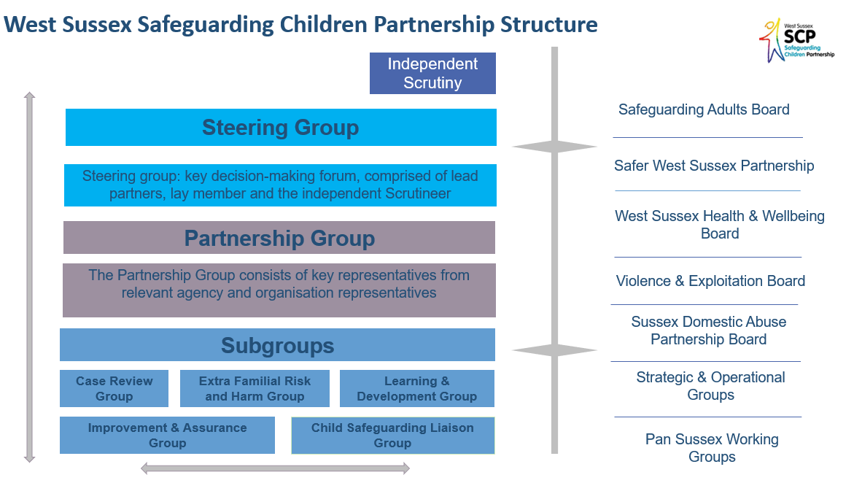
Our Shared principles
Promoting a culture of continuous learning - the partnership will create the environment for learning, recognising the way systems influence each other and the benefits of working together rather than in individual agencies.
High support high challenge - the partnership will promote a culture of high support and high challenge to develop working environments where growth and learning is accelerated.
Child Centred Practice - the partnership will ensure that children and young people have opportunities to participate and collaborate in the work of the Partnership and that the voice of children is embedded in multi-agency practice.
Working in this way we will ensure our core safeguarding practice is of high quality, responsive to the needs of our communities and improves outcomes for children and families in West Sussex.
9

Slide 10
Contact us
West Sussex Safeguarding Children Partnership:
WSSCP@westsussex.gov.uk
Our Website:
Home - West Sussex Safeguarding Children Partnership - West Sussex SCP
10

