Slide 1
West Sussex Safeguarding Children Partnership
Resolving Professional differences

Slide 2
About the West Sussex Safeguarding Children Partnership
Replaced Local Safeguarding Children Board in September 2019.
Statutory Guidance: “Working Together to Safeguard Children 2018” describes the need for:
“A shared responsibility between organisations and agencies to safeguard and promote the welfare of all children in a local area”.
Notes:
The purpose of these local arrangements is to support and enable local organisations and agencies to work together in a system where:
• children are safeguarded and their welfare promoted
• partner organisations and agencies collaborate, share and co-own the vision for how to achieve improved outcomes for vulnerable children
• organisations and agencies challenge appropriately and hold one another to account effectively
• there is early identification and analysis of new safeguarding issues and emerging threats
• learning is promoted and embedded in a way that local services for children and families can become more reflective and implement changes to practice
• information is shared effectively to facilitate more accurate and timely decision making for children and families

Slide 3
How do we work together effectively?
The purpose of the WSSCP is to support and enable local organisations and agencies to work together in a system where:
children are safeguarded and their welfare promoted
partner organisations and agencies collaborate, share and co-own the vision for how to achieve improved outcomes for vulnerable children
organisations and agencies challenge appropriately and hold one another to account effectively
there is early identification and analysis of new safeguarding issues and emerging threats
learning is promoted and embedded in a way that local services for children and families can become more reflective and implement changes to practice
information is shared effectively to facilitate more accurate and timely decision making for children and families

Slide 4
WSSCP Dispute Resolution & Escalation Protocol
Differences could arise in several areas of multi-agency working in relation to:
Criteria for referrals and levels of need
Outcomes of assessments
The need for action
Roles and responsibilities of workers
Service provision
Timeliness of interventions
Information sharing and communication
Use of WSSCP escalation
It is essential that where differences of opinion arise, they do not adversely affect the outcomes for children and young people and are resolved in a constructive and timely manner.
Notes:
Ensuring the safety of individual children is the paramount consideration in any professional disagreement. Any unresolved issues should be addressed with due consideration to the risks that might exist for the child.
All workers should be encouraged to be curious about why decisions are made and question if they do not feel this is right. Staff from any agency should feel confident and able to challenge decision-making; they will have a professional responsibility to promote the best multi-agency safeguarding practice. Professional challenge is a key part of effective safeguarding practice and therefore raising such concerns is an entirely legitimate activity.

Slide 5
Sussex Child Protection and Safeguarding Procedures
Chapter 7.2 Resolving Professional Differences
Professional Difference Statement:
The Pan Sussex Child Protection and Safeguarding Policy and Procedures Group recommend the following statement is read out at all relevant meetings:
It is acknowledged that when working in the arena of safeguarding, it is inevitable that from time to time there will be professional differences. This is a positive activity and a sign of good professional practice and effective multi-agency working. During this meeting practitioners, irrespective of their seniority are encouraged to say if they feel that decisions, practice or actions do not effectively ensure the safety or well-being of the child/children.

Slide 6
Process for Professional Resolution and Escalation of Concerns
Stage 1
1
Professional to Professional
Stage 2
2
Manager to Manager
Stage 3
3
Senior Manager to Senior Manager
Stage 4
4
Professional Leads for Safeguarding
Stage 5
5
Escalation to WSSCP
Stage 6
6
Escalation to Secretary of State

Slide 7
How to escalate a concern
Complete the escalation template – you can find it on the WSSCP website
Ensure you provide sufficient detail about your concerns
Copy the professional lead into your email to the WSSCP
We welcome your feedback on the escalation process – please tell us if it helped you to resolve your professional differences.

Slide 8
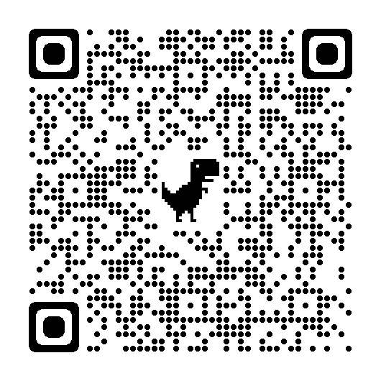
Scan the QR code above to view the Professional Curiosity and Escalations page on the WSSCP website

